Slide 1
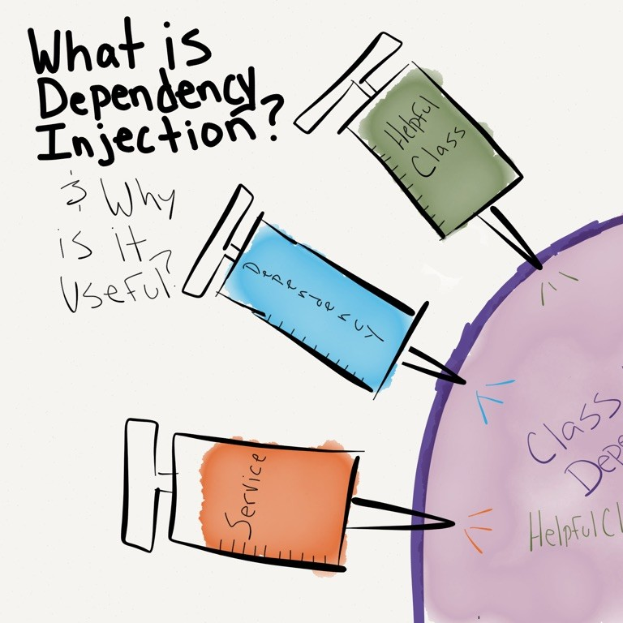
C♯ Dependency Injection Testing Entity Framework
Rasmus Lystrøm
Associate Professor
ITU

Slide 2

Agenda
Repository pattern
Testing database code
Dependency Injection
Fakes: Stubs and mocks
Testing Entity Framework
This Photo by Unknown Author is licensed under CC BY-NC-ND

Slide 3

The Repository Pattern
This Photo by Unknown Author is licensed under CC BY-SA

Slide 4
The Repository Pattern
Enable CRUD on domain objects (entities)
Usually: one repository per entity
Debatable: has a Save() method

Slide 5
Generic Repository
public interface Repository<T, K>
{
T Create(T entity);
IReadOnlyCollection<T> Read();
T Read(K id);
void Update(T entity);
void Delete(K id);
}

Slide 6
The Repository Pattern
… but wait … Entity Framework already does not for me!?

Slide 7
Recommended Repository: Per entity e.g., Character
public interface ICharacterRepository : IDisposable
{
int Create(CharacterDetailsDTO character);
CharacterDetailsDTO Read(int characterId);
IReadOnlyCollection<CharacterDTO> Read();
void Update(CharacterDetailsDTO character);
void Delete(int characterId);
}
…or something similar…

Slide 9
Thank you

